Slide 1
RA Derivation

Slide 2



Slide 3


Slide 4





Slide 5



Slide 6




Slide 7




Slide 8



Slide 9




Slide 10


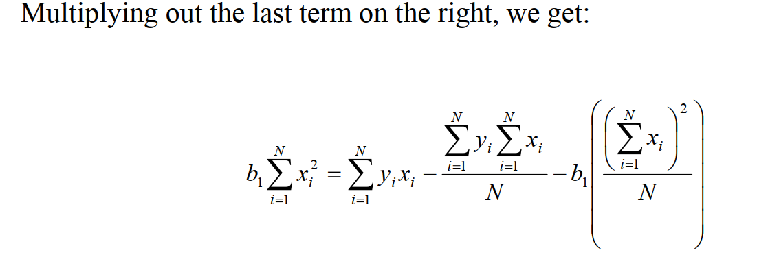

Slide 11



Slide 12


